Slide 1

Ridge Regression and Bayesian Linear Regression

Slide 2
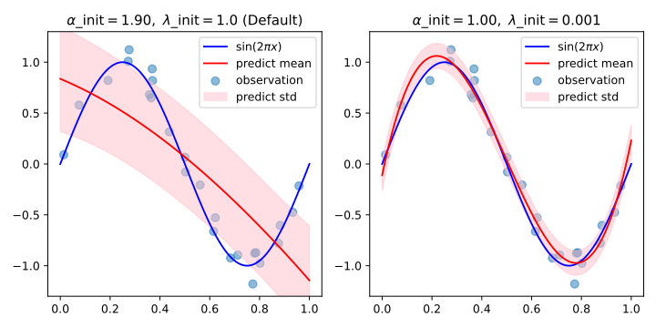
Ridge regression and Bayesian linear regression are both methods for linear regression, but they differ in their approaches to regularization and uncertainty estimation.
Ridge regression uses L2 regularization to prevent overfitting by penalizing large coefficients, while Bayesian linear regression incorporates prior knowledge about the parameters to produce probability distributions for them, providing a measure of uncertainty in the predictions

Slide 3
Motivation for Regularization
Overfitting in linear regression
High variance with multicollinearity
Need for a penalty to control model complexity
Ordinary Least Squares Recap
Model: y=Xw+ε
Loss function: L(w)=∥Xw−y∥2
No regularization

Slide 4
Ridge Regression – Introduction
Adds L2 penalty to the loss
Objective: L(w)=∥Xw−y∥2+λ∥w∥2
Ridge Regression – Interpretation
Penalizes large weights
λ\lambdaλ controls bias-variance tradeoff
Shrinkage effect illustrated
Ridge Regression – Solution
Closed-form solution: w=(XTX+λI)−1XTy
Matrix regularization via identity III

Slide 5
Ridge vs OLS Comparison
Table: OLS vs Ridge vs Lasso
When ridge performs better than OLS
Visual: effect of λ\lambdaλ on weights
Choosing λ (Regularization Parameter)
Bias-variance tradeoff curve
Cross-validation to select λ\lambdaλ
Visualization: MSE vs λ\lambdaλ
Ridge Regression – Geometric View
Contour plot of loss function
Circular penalty region (L2)
Intersection gives optimal www

Slide 6
Multicollinearity and Ridge
Ill-conditioned XTX
Ridge helps stabilize inverse
Better numerical properties
Feature Standardization
Why standardizing predictors is essential
Effect on penalty term and fairness
Ridge Regression – Example
Show small dataset and compare OLS vs Ridge
Show reduction in overfitting visually

Slide 7
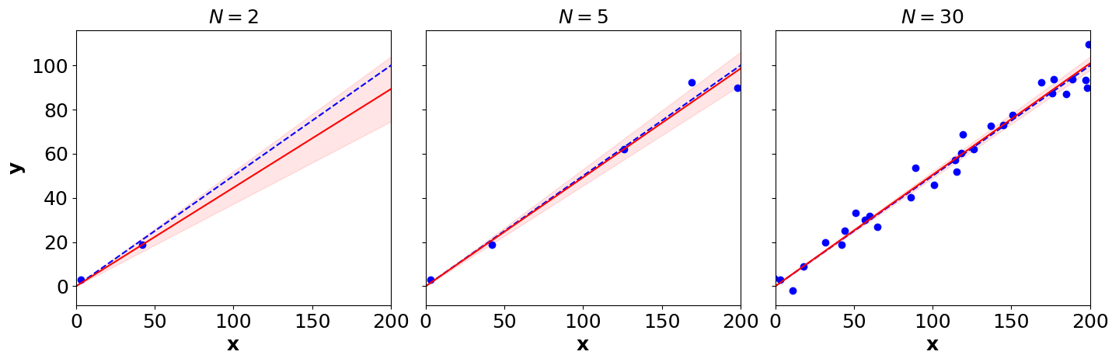
Bayesian Linear Regression
Bayesian linear regression is a statistical method that extends the concept of linear regression by incorporating prior beliefs about the model parameters.
Instead of providing a single best-fit line, it produces a probability distribution over possible parameter values, allowing for a more nuanced understanding of uncertainty.

Slide 8
Motivation for Bayesian Approach
Deterministic point estimates vs distributions
Incorporate uncertainty and prior knowledge
Bayesian Linear Regression – Setup
Likelihood: p(y∣X,w,β)=N(y∣Xw,β−1I)
Prior: p(w)=N(w∣0,α−1I)
Posterior Distribution
Posterior is also Gaussian: p(w∣y,X)=N(w∣mN,SN)
Where: SN=(αI+βXTX)−1
mN=βSNXTy

Slide 9
Comparison with Ridge
Ridge solution is MAP estimate in Bayesian framework
λ=αβ
Ridge = point estimate; Bayesian = full distribution
Bayesian Prediction
Predictive distribution: p(y∗∣x∗,X,y)=N(y∗∣x∗TmN,x∗TSNx∗+β−1)
Includes mean and variance (uncertainty)
Posterior and Predictive Visualization
Plot
Posterior mean with uncertainty band
Sample functions from posterior

Slide 10
Effect of Priors
Strong vs weak priors
Overfitting control using priors
Prior acts like a regularizer
Incremental Learning
Bayesian updating with new data
Prior becomes posterior for the next batch
Marginal Likelihood (Evidence)
p(y∣X,α,β)helps tune hyperparameters
Model selection via evidence maximization

Slide 11
Advantages of Bayesian Linear Regression
Uncertainty quantification
Robust to small data
Naturally handles regularization
Limitations
Requires matrix inversion (computationally expensive)
Assumes Gaussian priors and noise
Not always closed-form for complex priors

